Slide 1

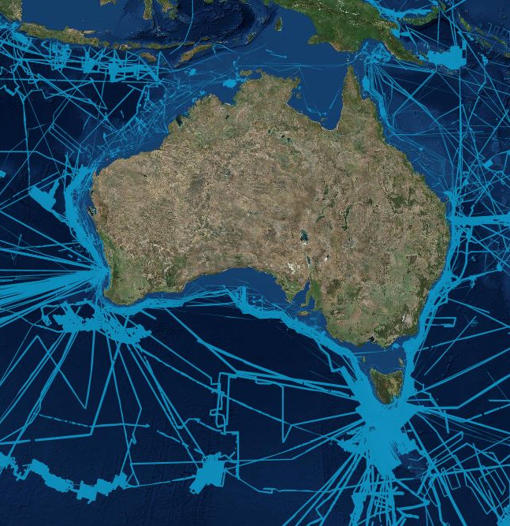

AusSeabed - Workshop
12 July, 2019 AMSA, Perth

Slide 2
Thank you to our great host in WA Ralph Talbot-Smith and to our host at Fremantle Ports, Jay Illingworth.
Thank you to Ralph, Iain and Aero for the symposium
Who is new?

Slide 3
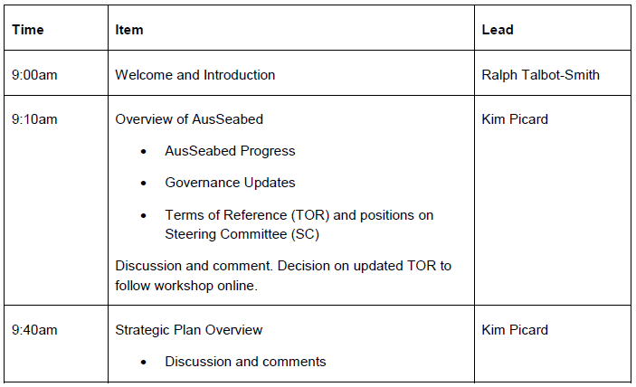
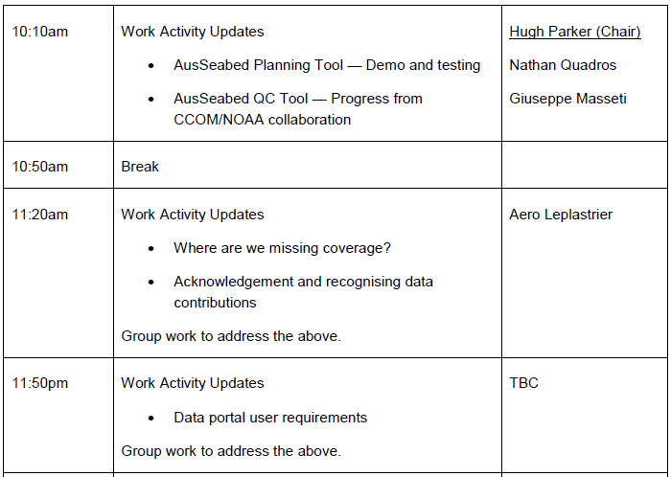
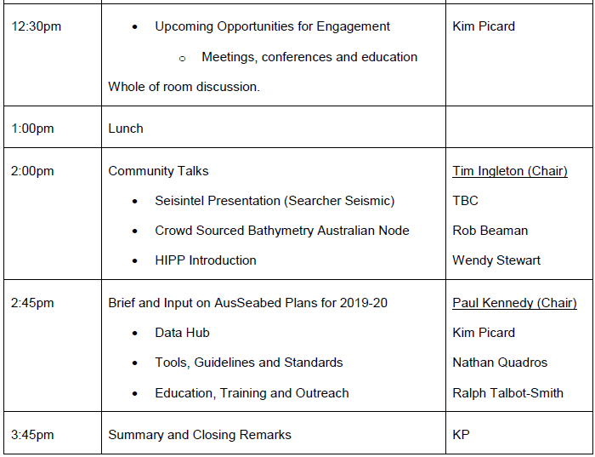
Workshop Agenda

Slide 4
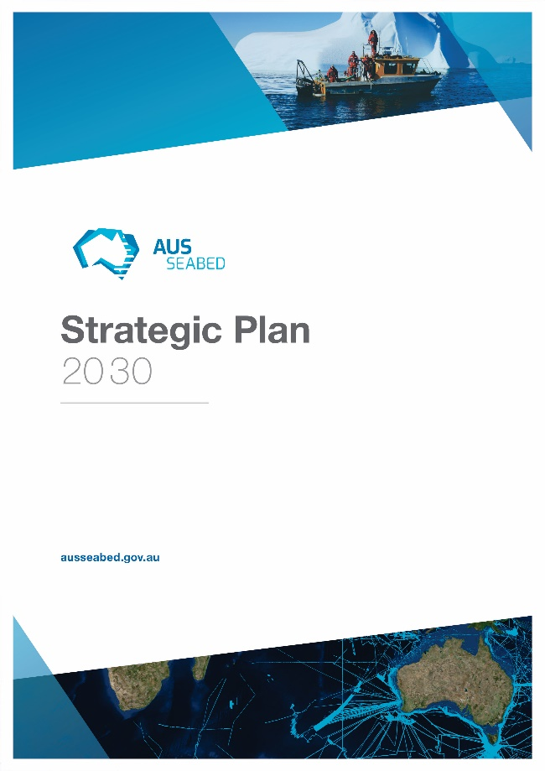
Our Vision
By 2030, all available seabed mapping data within the Australian Marine Estate will be readily and openly available, and new data acquisition will take into account the needs of a wide range of users.
Our Mission
To improve the coverage, awareness, quality, discoverability and accessibility of seabed mapping data for the Australian community.
In press
Notes:
This can’t be done without SDB
AusSeabed is becoming the national coordination program for seabed mapping in Australia (Click).
Australian Government initiative started late 2016 represented by Governments, Universities and Industry to develop initiatives and products to improve the quality, discoverability and accessibility of seabed mapping data for the Australian community.
There are presently 19 partners and AusSeabed is a growing initiative and reflects the need for seabed mapping coordination in Australia.
The partners have been meeting bi-annually to direct and develop various initiatives.

Slide 5
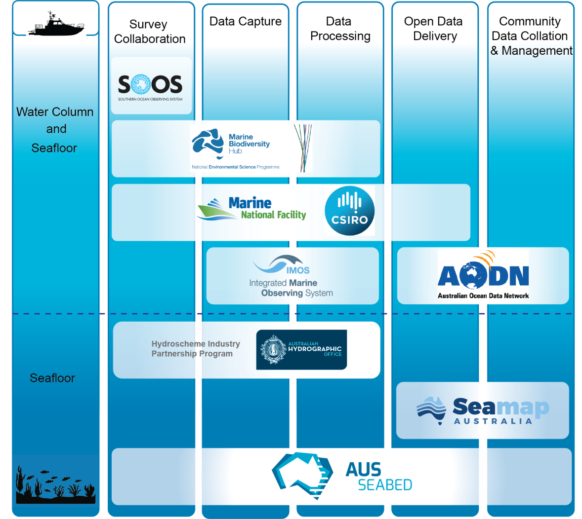
Australia seabed data system

Slide 6





Goals of the Program
Improve the curation and delivery of seabed mapping data
Improve the standards and quality related to seabed mapping procedures and data
Nationally coordinate seabed mapping activities and objectives
Demonstrate the value of seabed mapping data for decision-making
In press
Program themes
Data hub
Tools, Guidelines and Standards
Outreach, Education, and Training
Notes:
This can’t be done without SDB
AusSeabed is becoming the national coordination program for seabed mapping in Australia (Click).
Australian Government initiative started late 2016 represented by Governments, Universities and Industry to develop initiatives and products to improve the quality, discoverability and accessibility of seabed mapping data for the Australian community.
There are presently 19 partners and AusSeabed is a growing initiative and reflects the need for seabed mapping coordination in Australia.
The partners have been meeting bi-annually to direct and develop various initiatives.

Slide 7

Governed by
ASB Steering Committee
Government Representatives
Australian Hydrographic Office
Standing
Committee
Members
Academic Representatives
General
Committee
Members
Geoscience Australia
Private Sector Representatives
CSIRO
International Representative
Notes:
AusSeabed is becoming the national coordination program for seabed mapping in Australia (Click).
Australian Government initiative started late 2016 represented by Governments, Universities and Industry to develop initiatives and products to improve the quality, discoverability and accessibility of seabed mapping data for the Australian community.
There are presently 19 partners and AusSeabed is a growing initiative and reflects the need for seabed mapping coordination in Australia.
The partners have been meeting bi-annually to direct and develop various initiatives.

Slide 8













AusSeabed evolution
Workshop 6 & 7
Data Standards &
Effective seabed mapping workflow
NOAA/CCOM collaboration
QC tools
ASB Planning tool & MBES user report
Datasets release
Newsletters debut
Strategic Plan in review
Government Priority Map released
Workshop 2 & 3
MBES Guidelines & National Tools
2017
2019
2016
2018
2020
Workshop 1 Government Priority Map
Australian MBES Guidelines published
Workshop 4 & 5
Governance & Data management model
Steering Committee established
Operational Data Hub
&
Continuation of program themes activities
Annual work plan to be published
SEABED 2030

Slide 9













2019-2021 AusSeabed Steering Committee
Sectors | Organisation | Representative
Standing Members
Standing Members (Commonwealth) |  | Kim Picard (Chair), Wendy Stewart, Tara Martin
General Members
Government (Commonwealth) |  | Johnathan Kool
Government (State) |  | Tim Ingleton, Ralph Talbot-Smith, Daniel Ierodiaconou*
Academia |  | James Daniell, Vanessa Lucieer
Private |  | Paul Kennedy, Hugh Parker, Nathan Quadros (Vice-chair)
International |  | Geoffroy Lamarche
*Daniel Ierodiaconou from Deakin University is representing the State of Victoria for matters that concerns AusSeabed, by request from DELWP

Slide 10
Steering Committee meeting - ToR
ToR - Endorse changes
Chair will be one of the standing members
Three meetings per year
  (Jul, Nov/Dec, March)
Vice-chair additional tasks (prior with Secretary role):
  Help the Chair to plan meetings
  Organise logistics of the meetings
Quorum on voting for Chair & vice-chair role:
  Chair vote is deciding vote in tie-break
  For Chair role, tie-break resolve with quorum of standing members
  Endorsement by community?

Slide 11
Business Case for Executive Board
AusSeabed Executive Board
GA
CSIRO
AHO
AIMS
AAD
Others
Independent Industry Body
Adviser
AusSeabed Steering Committee
AHO
Government Representatives
GA
Standing
Committee
Members
Academic Representatives
General
Committee
Members
CSIRO
Private Sector Representatives
AIMS
International Representative
AAD
Advises and contributes to program themes
Tools, Guidelines, and Standards
Working Group
AusSeabed
Datahub
Working Group
Outreach, Education, and Training Working Group

Slide 12
Role of (proposed) Executive Board
Endorse SC direction and workplan
Approve their contributions to the budget (BAU plus project based funding)
Funder of the program through (in-kind/resources) (requirement for membership)
Contribute to building the infrastructure or any ASB deliverable
ASB will not be collecting data (commissioning surveys)
Ensure the strategy of ASB aligns with the strategy of the agency and vice-versa.
The EB will made of a commonwealth core and will be expandable to other governments. Other sectors voice or contribution will be through the SC.
Meet twice a year for traffic light on budget tracking
Idea: The EB will have an Independent Industry Body Advisor

Slide 13
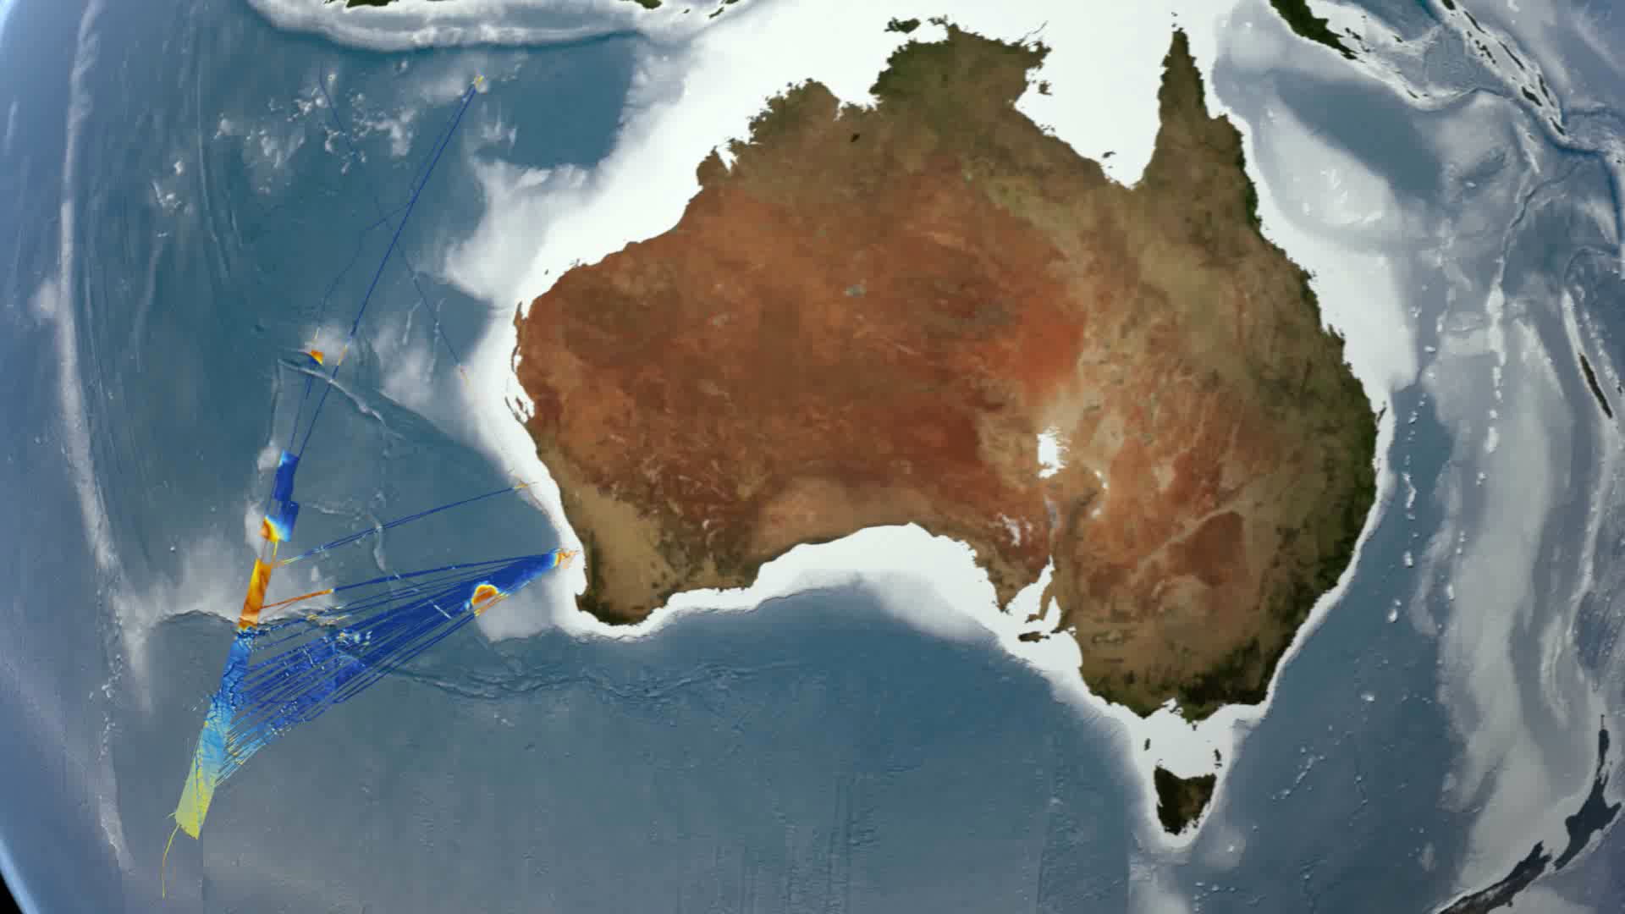

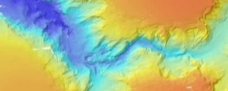
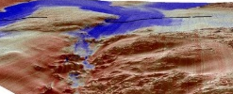

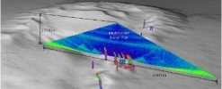
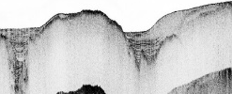


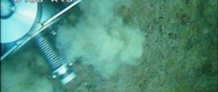





Data Hub: A distributed open access cloud-based platform
Local hub
Product suites
Other data providers
Bathymetry
Local hub
Backscatter
MBES Water Column
Sub-Bottom Profiles
Sediment Samples
Apps & Tools

Slide 14
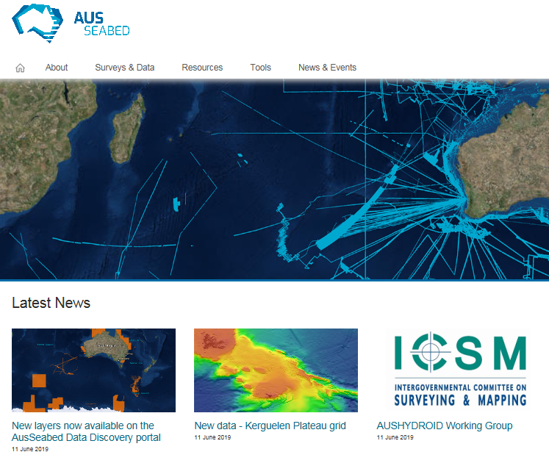
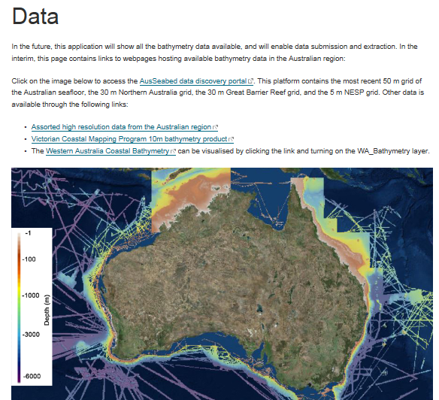
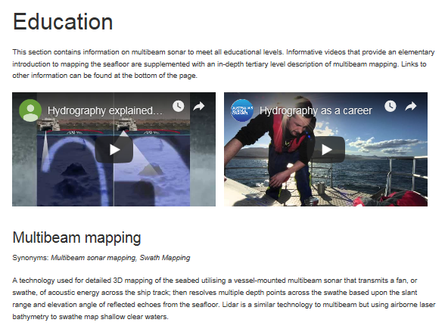
Tools, Guidelines and Standards: Website
1,600 Users
Data and Education most popular

Slide 15
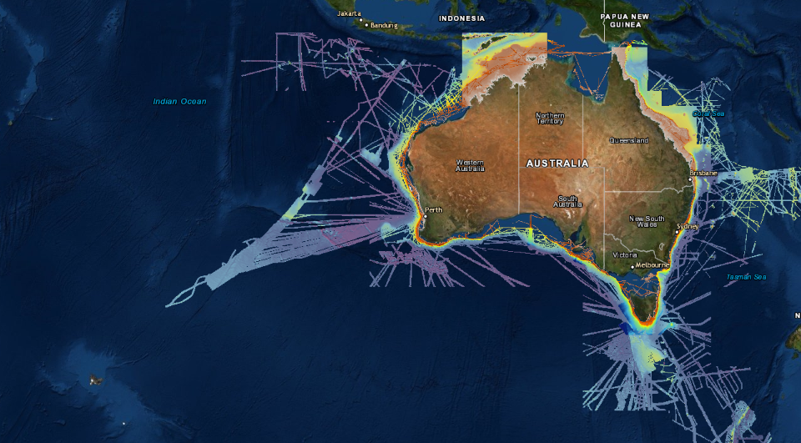
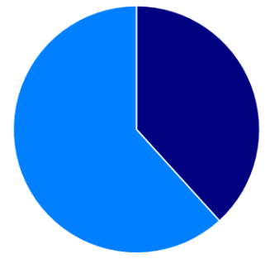


Data downloads in 2019
NT
GBR
ArcGrid
GeoTiff
1875
MH370
5 m
50 m

Slide 16
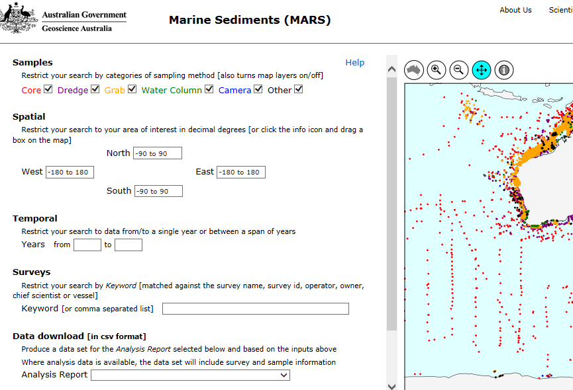
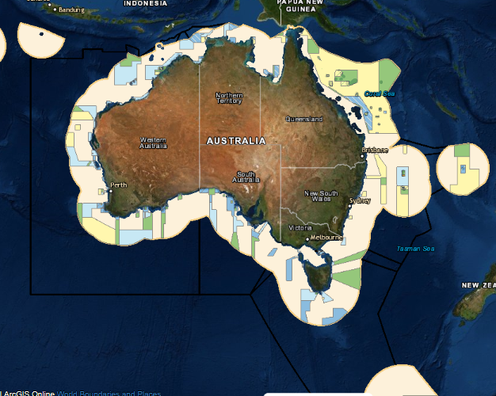
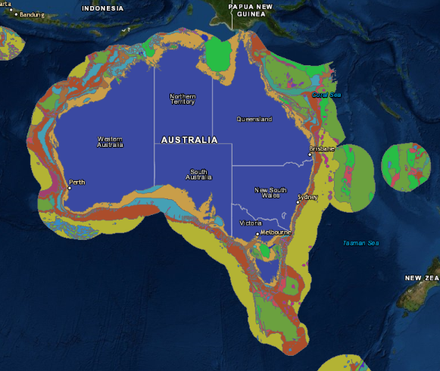
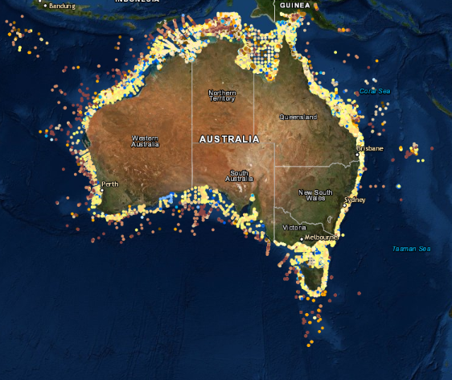
New layers
EEZ
Offshore Marine Parks
State Areas (OPGGS)
Geomorphology
Sediments

Slide 17
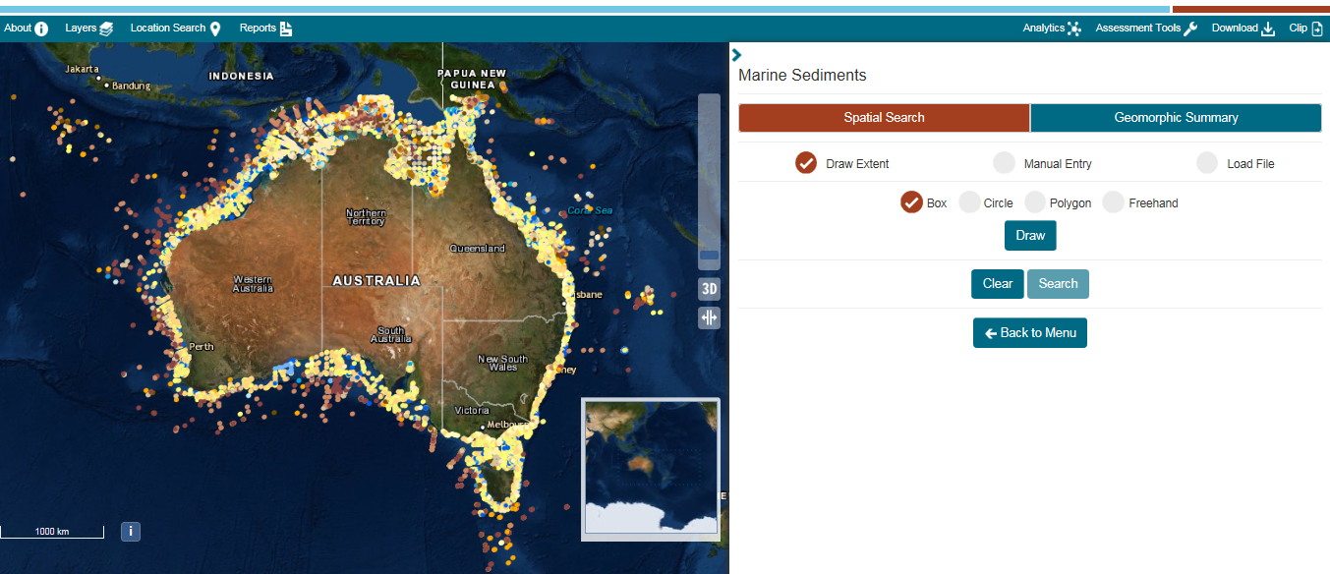
Upcoming – Sediment data analytics

Slide 18
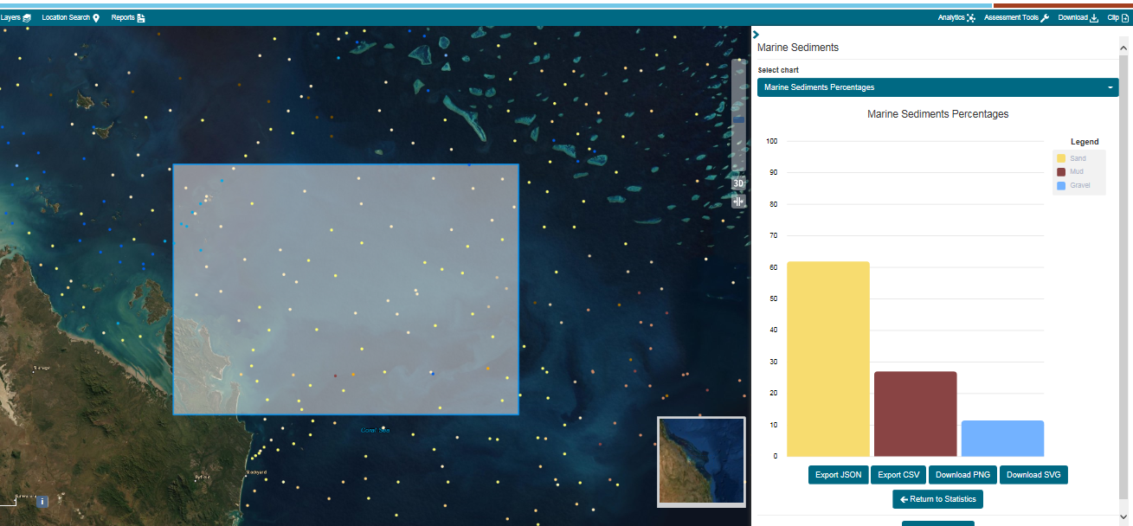
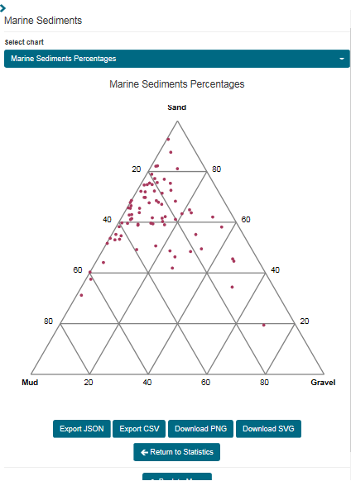
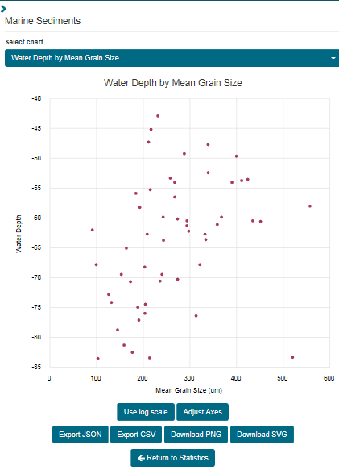
Upcoming - Sediment data analytics

Slide 19
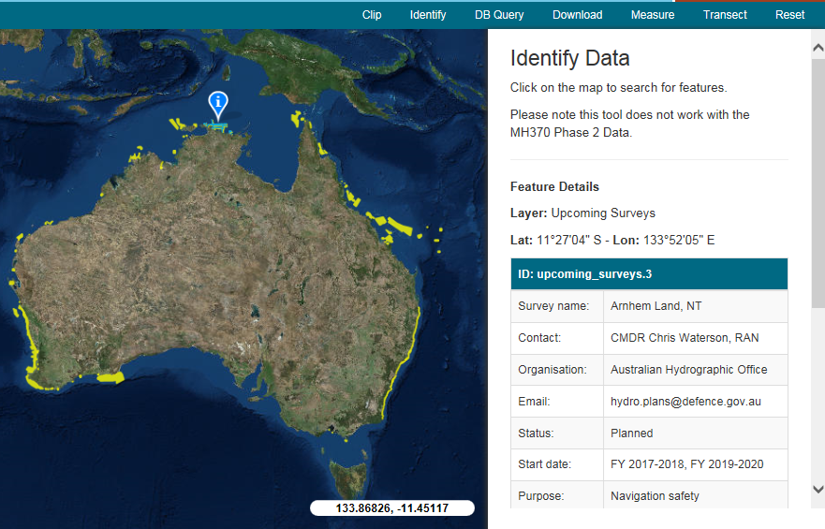

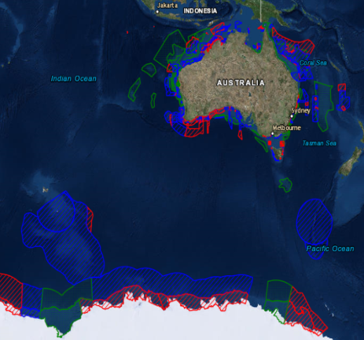

Tools, Guidelines and Standards
Guidelines development
Bathymetry priority map
Upcoming survey register
Bathy Lidar
Satellite-Derived bathy
Sub-bottom
Etc..

Slide 20
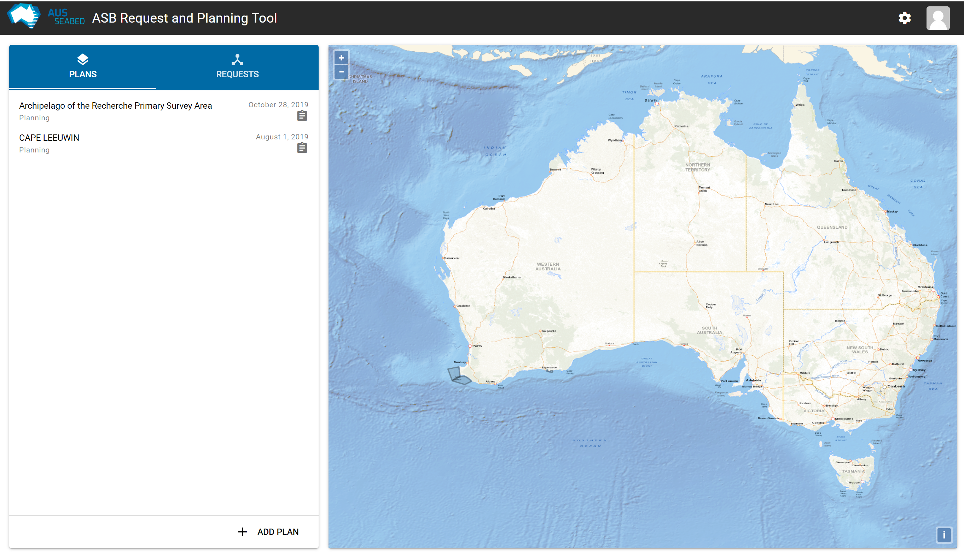








Tools, Guidelines and Standards
Survey planning tool
Automated QA checks
QAX
Upcoming areas
Specification design
MATE

Slide 21
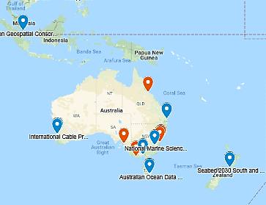

Outreach, Education and Training
Community engagement tracking
SSSI accreditation by participating to AusSeabed events
Lecture to Royal Australian Navy Hydrography School: raise awareness of other data type and applications
CSIRO MNF – Collaborative Australian Postgraduate Sea Training Alliance Network (CAPSTAN)

Slide 22
Tomorrow: AusSeabed workshop 0900-1600
Thank you
Special thanks to GA team:
Aero, Natalie, Georgy, Justy, Michele, Katherine, Robert, Maggie, Janna, Callum, Wenjun
NESP workshop –Portal for Science Communication
Hobart, 28 Sept
OceanObs ‘19
Hawaii, 16 Sept
GEBCO week
CCOM, USA, 6 Nov
AusSeabed Steering Committee
Nov 19
AGU Fall meeting 2019
San Francisco, 11 Dec
AusSeabed : www.ausseabed.gov.au and ausseabed@ga.gov.au

Slide 23
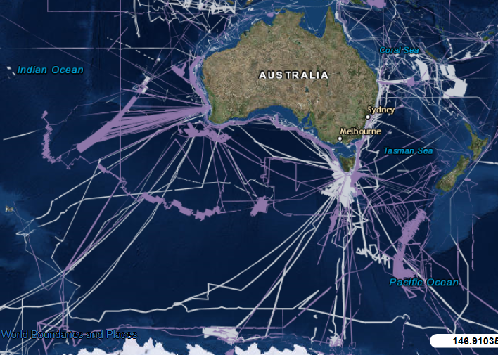
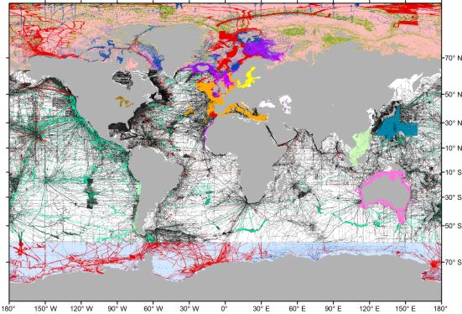
Conclusion: Build a complete picture
GEBCO 2014 grid source id dataset

Slide 24
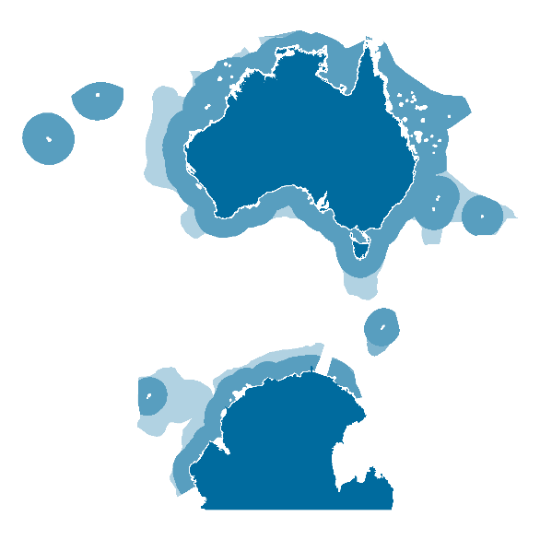
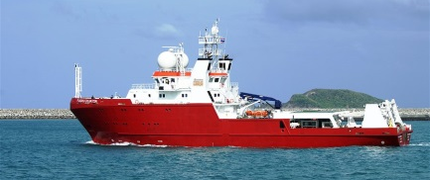
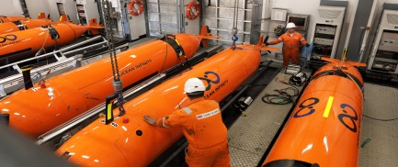
Conclusion: It’s possible
To map 0-200 m (shelf edge only no external territories):
Common methodology:
~ 190 yrs (1 ship/24hrs) @ 200k line m/yr
(Credit for these calculations: IX Blue –Thanks)
Recent methodology:
~25 yrs (based on MH370 experience)
It’s possible
2015
120,000 km² in 2 yrs
2018
120,000 km² in 3mths

Slide 25
Steering Committee meeting – Strategic Plan
Addition:
Overview: Add statement on the economic value of seabed mapping
Table : Value Proposition per sector
Endorsement?

Slide 26
Activity: AusSeabed Planning Tool Demo and Testing
Carried out using individual laptops.

Slide 27
QAX
Towards Automated Quality Assurance Checks
v0
Giuseppe Masetti, Kim Picard, and Tyanne Faulkes
Freemantle, Perth - July 12, 2019

Slide 28
Data Hub: A distributed open access cloud-based platform
Local hub
Product suites
Other data providers
Bathymetry
Local hub
Backscatter
MBES Water Column
Sub-Bottom Profiles
Sediment Samples
Apps & Tools

Slide 29




Data hub: End to end capability
QA & Package
  For use during acquisition
  Repository of QA checks
  Interface to run QA tool
  Package data for delivery
Survey
Planning
  Upcoming surveys details
  Design specs and templates for tendering
  Specs for future data QA
Analytics & Delivery Portal
  Display and discovery capability
  Accessibility to compilation ‘on-the-fly’
Processing pipeline
  Process data to consistent standard
  Prepare data for collection index
Collection & Archive
  Consistent data structure and quality
  Delivery channels
  Data holding consistent with global marine community
Provenance (metadata)

Slide 30





















AusSeabed
Data Pipeline
Hydro-scheme
AAD
voyages
HydroScheme
Review Panel (HRP)
Gov & Science
Priorities
HIPP
Advisory Board
HYDROGRAPHER of AUSTRALIA
HYDROSCHEME
TASK LIST
MNF voyages
Survey
Proposal
HIPP
PLANS HARMONISATION
HydroScheme Endorsed
Survey assigned
GENERATE
REQUIREMENTS
SPECIFICATIONS
TEMPLATE
Survey plan
COLLECTOR
DATA ACQUISITION
PRIORITY MAP
PLANNING
UPCOMING SURVEY
Full data
delivery
User
QUALITY
ASSURANCE
QUALITY
ASSURANCE
Validation
DISCOVERY & DELIVERY
ANALYTICS
for on-the-fly delivery
OTHER DATA
INFRASTRUCTURE
DELIVERY
PACKAGE
AHO DATA HUB
PRODUCTS
DATA HUB
AHO specific
AusSeabed
PRODUCTS & SERVICES
PROCESSING
ARCHIVE

Slide 31
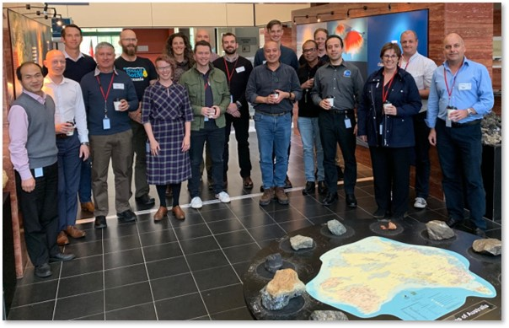

AusSeabed-NOAA-CCOM Workshop
“Effective Seabed Mapping Workflow”
Dates: 18-20 June 2019
Topics:
  Processing workflow of Geoscience Australia & NOAA Office of Coast Survey
  Pydro (Barry Gallagher)
  HydrOffice
  QC Tools, CA Tools
  Charlene, Sham, TCARI (Erik Younkin)
  GA planning Tool
  MAC Tools (Paul Johnson)
  Sound Speed Manager & SmartMap
  StormFix
  BSIP & OpenBST
  BAG & BAG Explorer

Slide 32
Workshop Outcomes
Raw Survey Data
QA Checks
Survey Products
Notes:
One of the main outcomes from the workshop has been the identification of two main lines of action for quality assurance checks. One targeting raw survey data, the second one survey products such as DTMs.

Slide 33


Workshop Outcomes
Raw Survey Data
QA Checks
Notes:
QC Tools:
- Performs automated quality control checks on surfaces and final feature files.
- Used iteratively in the field and at the processing branch to monitor and evaluate data to meet specifications.
CA Tools:
- Performs chart adequacy tasks by comparing survey data and current ENCs.
- New ability to create a sounding selection from a DTM.

Slide 34

Workshop Outcomes
Multibeam Acquisition and Tracking Evaluator (MATE)
QA Checks
Notes:
Multibeam Acquisition and Tracking Evaluator (MATE)
- Quality analysis on raw data.
- Used near-real-time on the vessels and when data arrives at the processing office.
- Starting with Kongsberg .all data with a number of checks for the proof of concept.
- More checks will be added with more community input.

Slide 35
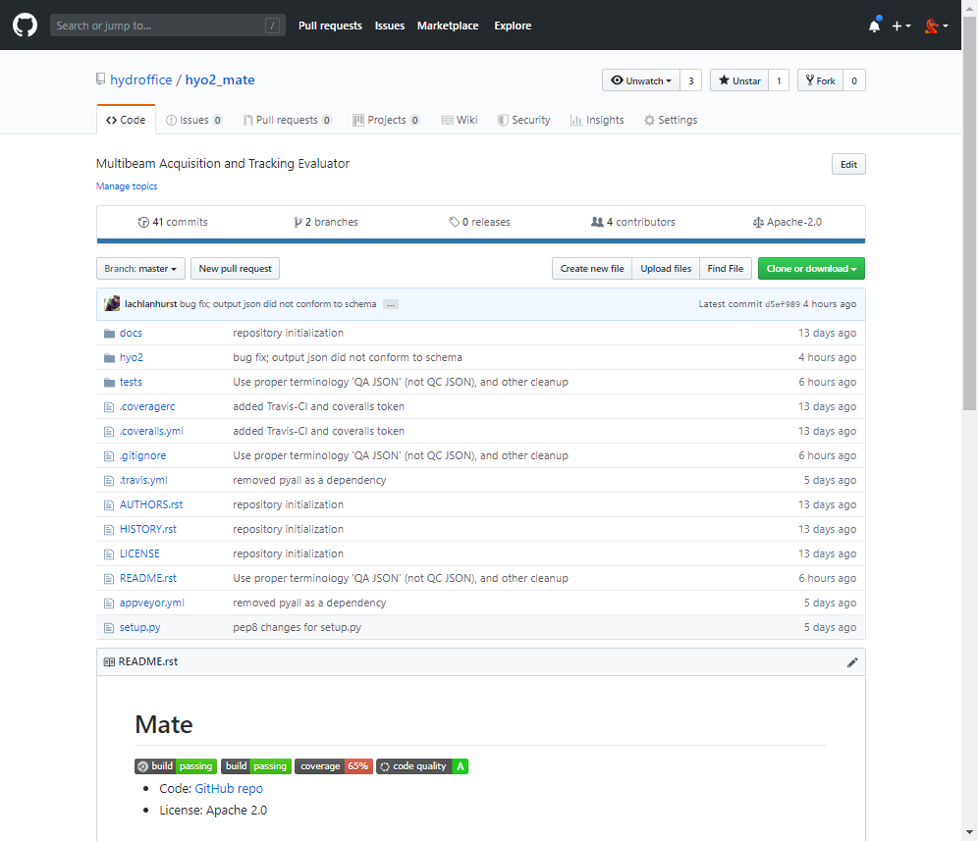

MATE on GitHub

Slide 36
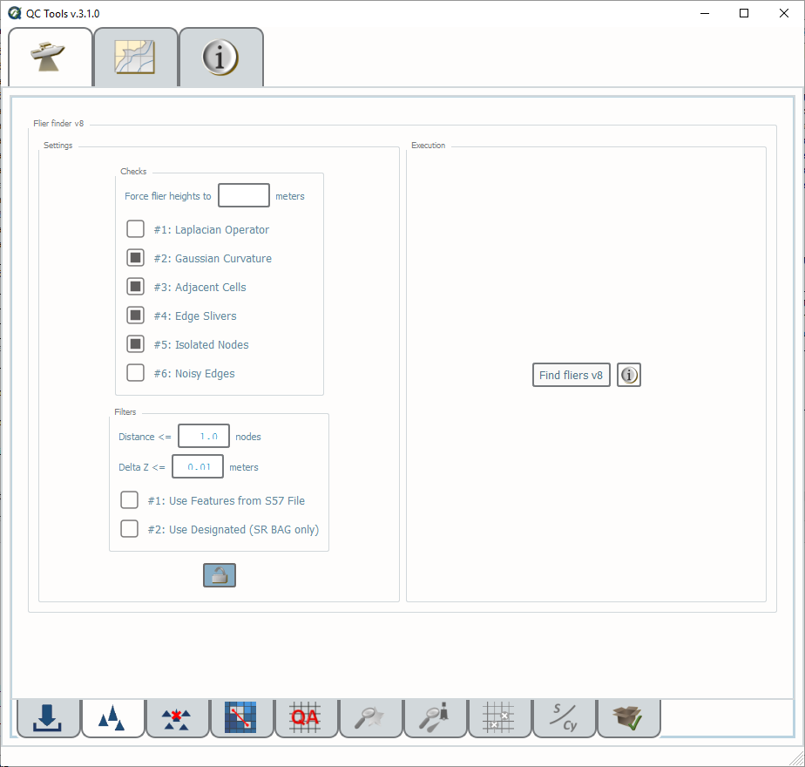
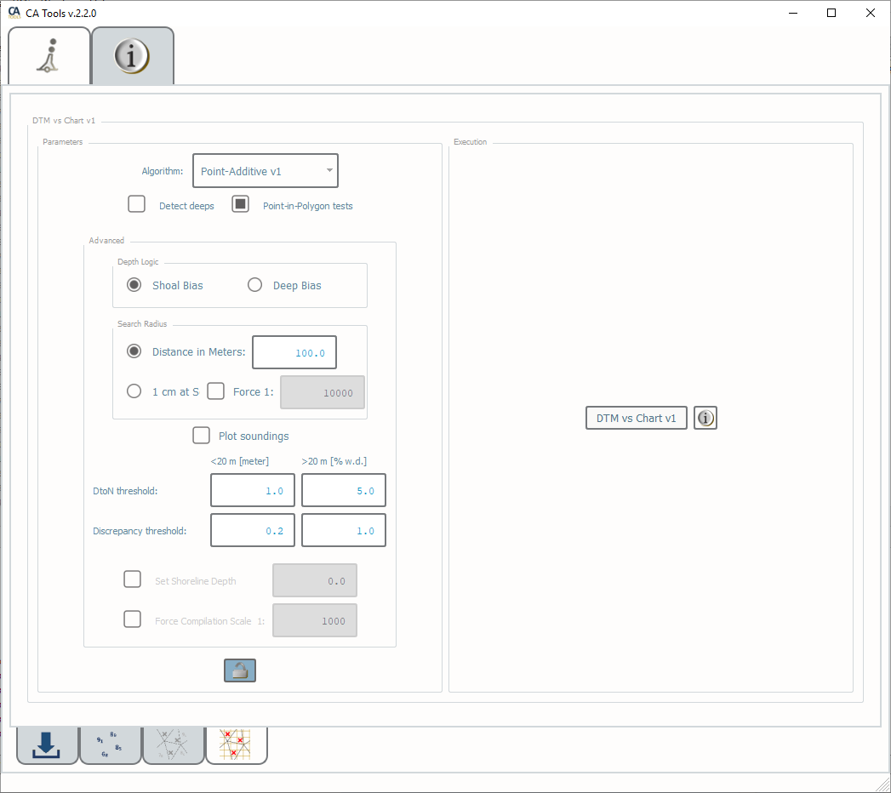
Existing Mode: User-Interactive
Notes:
With the currently available mode, the user has to manually interact with each QC tool.

Slide 37
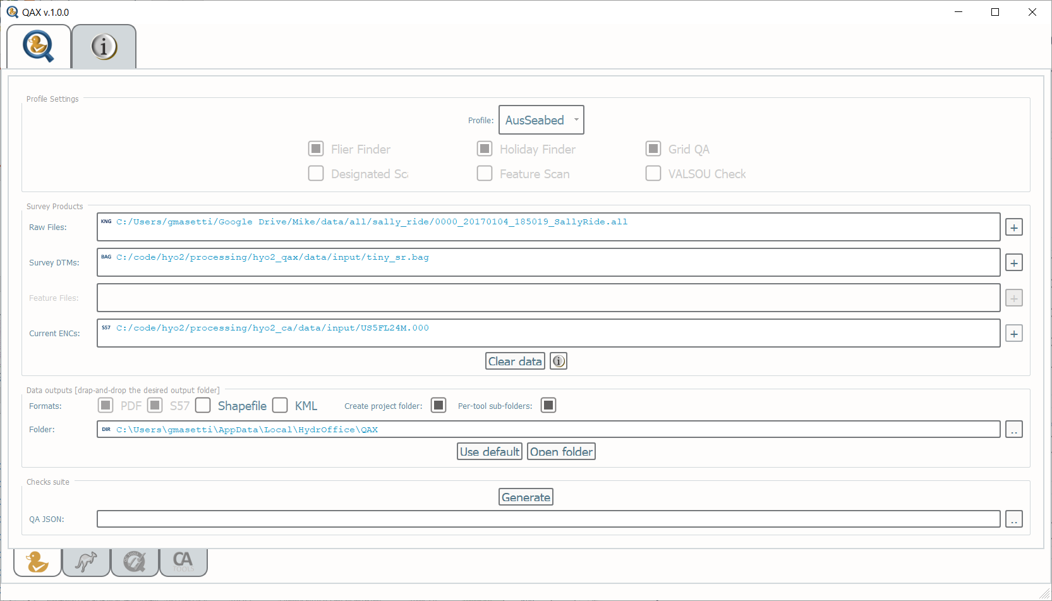
Coming Mode: Profile-Based
QAX
QA Checks

Slide 38


Coming Mode: Profile-Based
QAX
QA Checks
QA JSON
JSON + JSON Schema

Slide 39
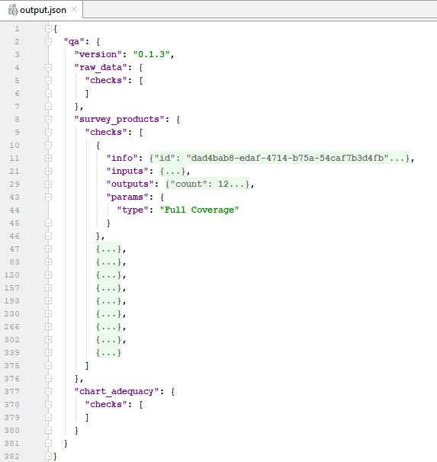
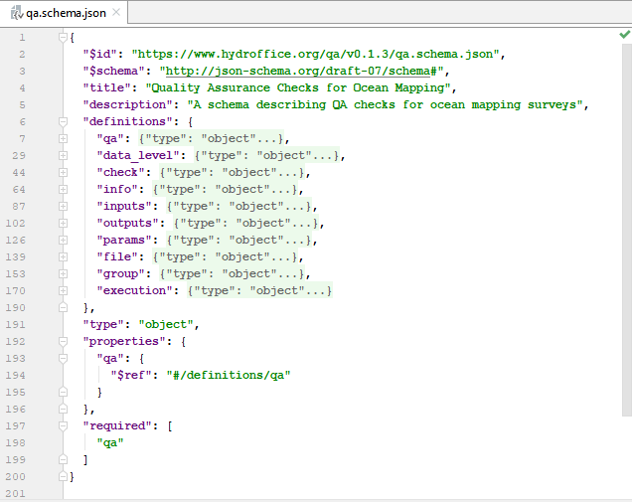

QA JSON
JSON Schema

Slide 40
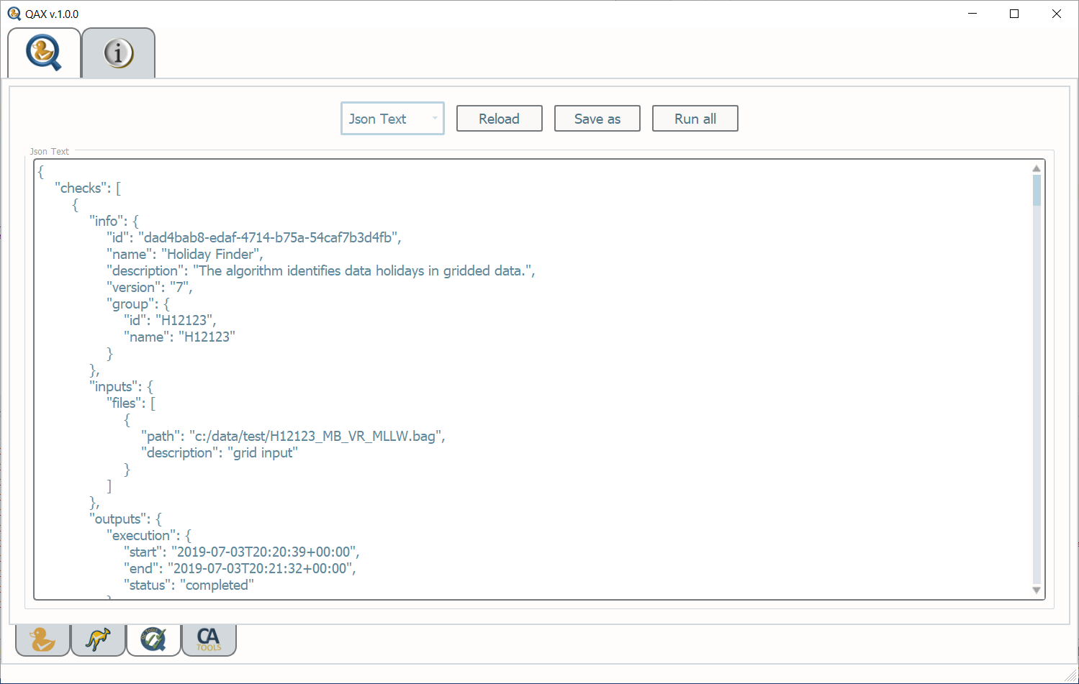
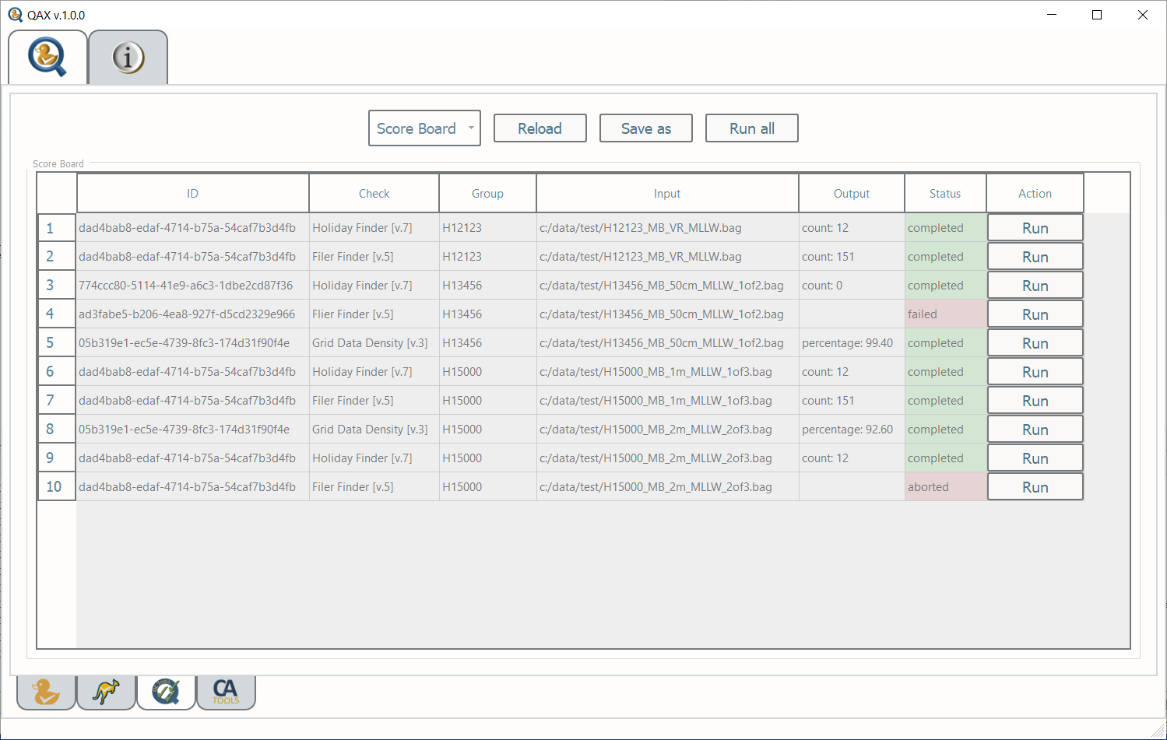
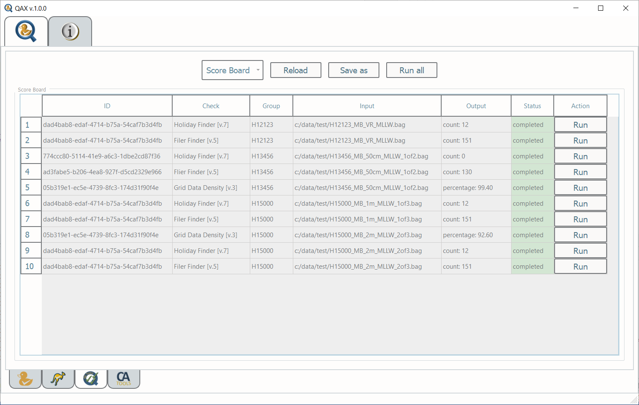
QAX Visualization: QC Tools

Slide 41
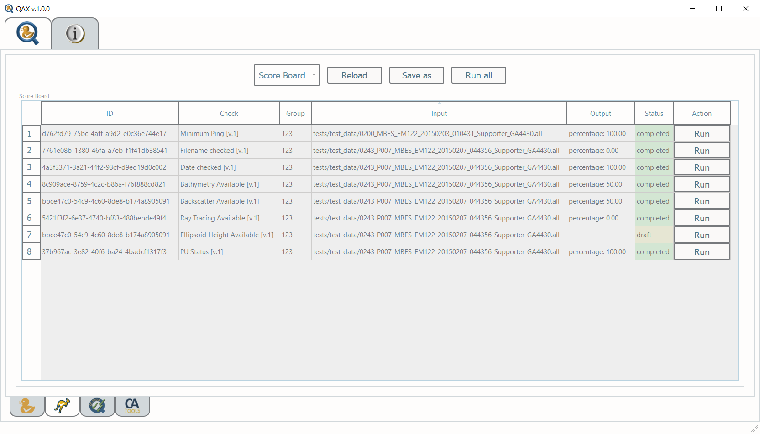
QAX Visualization: Mate

Slide 42
Development Plan
CCOM Site Review Participation (July 19) – Progress update
Official Release of QA Schema 1.0.0
QA JSON adoption for input/output of QC Tools and CA Tools
Beta Release of MATE
Definition of NOAA and AusSeabed profiles
First Official Release of MATE (1.0.0)
Integration of MATE into QAX
First Official Release of QAX (1.0.0)
… and your ideas !!!

Slide 43

THANKS!
Visit us at: www.hydroffice.org/qax

Slide 44
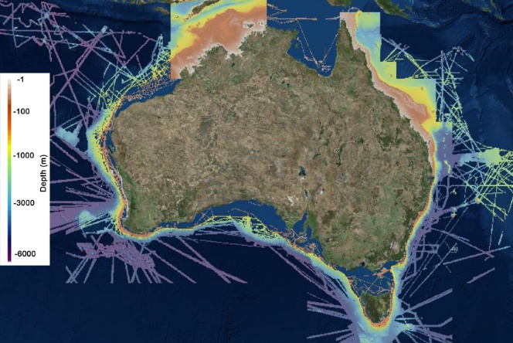
Activity: Where are we missing coverage?
Break out into groups
Add comments on maps around rooms where there is missing coverage.

Slide 45
Activity: Group coverage identification
As a table go and assess a coverage map.
Is your entity’s coverage displayed on the map?
If it isn’t, mark an approximate area and allocate it a number.
On the blank sheet behind write down the allocated number, the name of your organisation and a contact that can provide a shapefile of the coverage.
no | entity | name | email
1 | GA | Aero Leplastrier | aero.leplastrier@ga.gov.au

Slide 46
Metadata Fields for Data Coverage
Attributes
GA identifier (GAMSI)
Bathymetry Type (e.g Multibeam)
Project title
Collection organisation code (your code for the survey)
Ship
Principal Investigator (Name and email)
Collecting Institution
Start Date (YYYY-MM-DD)
End Date (YYYY-MM-DD)
Start port
End Port
Northern Extent
Southern Extent
Western Extent
Eastern Extent
Coverage (KM^2)
Multibeam Sonar System(s)

Slide 47
Metadata Fields for Data Coverage
Attributes cont’d
Flag state:
Fraction edits
Embargo
Data Access URL
Processed (yes/no)

Slide 48
Activity: Data Portal user Requirements
Participants carried out user testing on the AusSeabed portal using laptops around the room, with suggestions taken down by facilitators.

Slide 49
Activity: Upcoming Opportunities for Engagement
Whiteboard session with suggestions fielded from participants.

Slide 50
AusSeabed Community Talks
Hydroscheme Industry Partnership Program – Wendy Stewart
Crowdsourcing Bathymetry Update – Robin Beaman

Slide 51
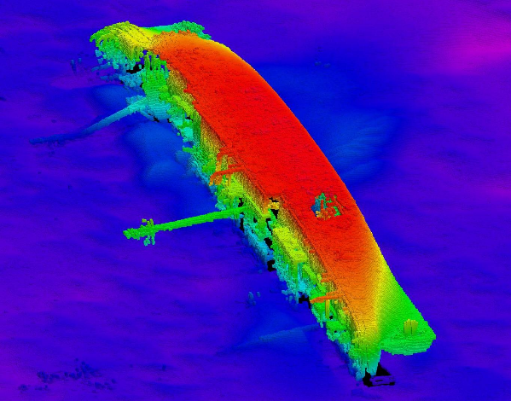
SEA2400-1 HydroScheme Industry Partnership Program (HIPP) - Update
CMDR Wendy Stewart
Deputy Director Hydrographic Plans and Standards (DDHPS)
Australian Hydrographic Office (AHO)
July 2019
Notes:
51

Slide 52
Background
Need for Change
  Growing realisation that there is a need to better understand our physical environment including the maritime domain
  Current guidance provided through Defence White Paper 16 → Defence project SEA 2400
Efficient combination of commercial and military capability
  Partner with Industry to delivery the National Survey Function → HydroScheme Industry Partnership Program (HIPP)
  Deliver a hydrographic and oceanographic capability to support unique military requirements
Notes:
52
Modern Military has a greater need to understand the environment – from weather windows for operations to inputs into sensors and weapons – driving a need to change the way the current Hydrographic Foprse is utilized to suppprt these requirements.
Currently Navy conducts surveys to support the National Survey Function – survey fleet was purchased to support this function.

Slide 53
HIPP Timeline - Key Dates
STAGE | DATE | STATUS
Request For Tender Advertised | 8 December 2017 | ✓
Closing Date for RFT | 29 March 2018 | ✓
Tender Evaluations | 2rd to 4th quarter 2018 | ✓
ODIA Process – clarifications to responses | 1st & 2nd quarter 2019
Resubmit tender responses | 3rd quarter 2019
Tender Evaluations | 3rd quarter 2019
Government Approval Process | 4th quarter 2019
Panel commences | 4th quarter 2019
First surveys delivered to AHO | 2nd quarter 2020

Slide 54
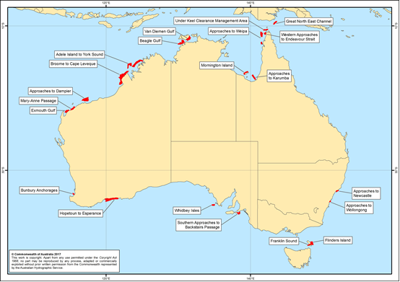
HydroScheme
  RFT HydroScheme - five-year plan outlines hydrographic surveying activities programmed within the Australian Charting Area (ACA) for Phase 1.
54
Notes:
54
[read out caveat on slide]
As you can appreciate, SEA2400-1 requires numerous complex commercial considerations. There are limits to the detail of what we can disclose at this briefing but we will do our best to answer any questions we can within the legal limits of the processes.
[change slide]

Slide 55
HydroScheme 2020-2021 (Proposed)
  Currently updating HydroScheme to develop the surveying program for the first 18 months HydroScheme 2020-2021
  to be released in September 2019 following decisions made by the HydroScheme Review Panel (HRP) at its inaugural meeting chaired by the Hydrographer in late August 2019
  Will supersede HydroScheme 2017-2020
  New approved format - more descriptive and it is intended to be published on a new website interface.

Slide 56
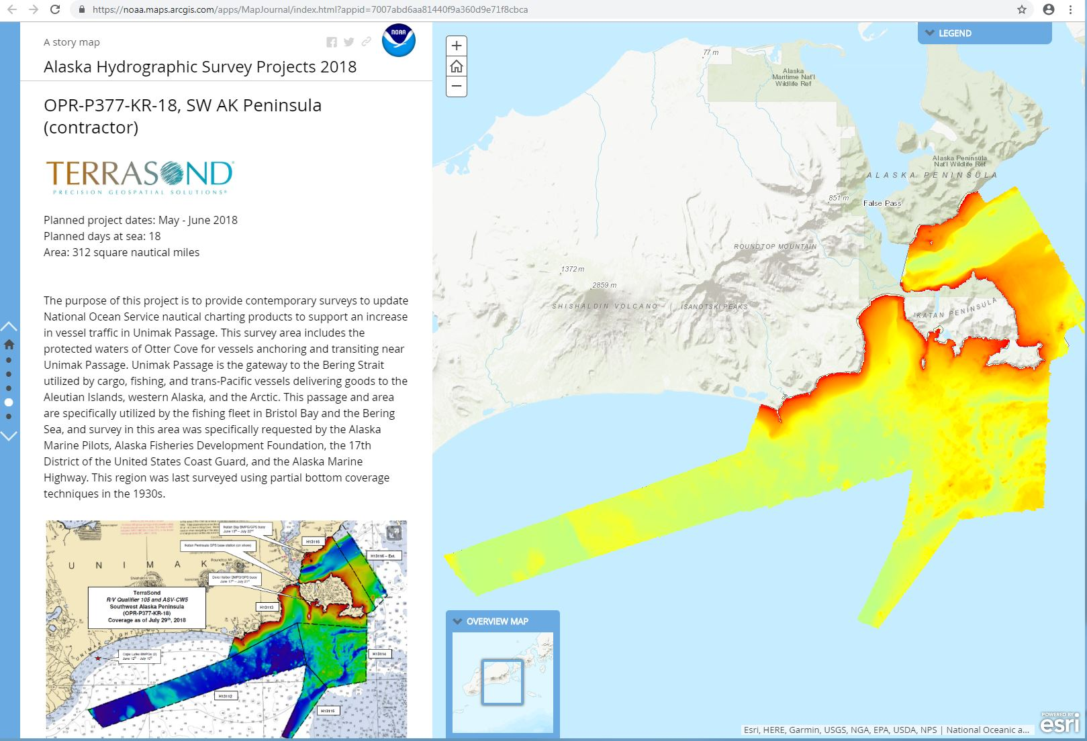
HydroScheme Task Example – new web format

Slide 57
New Survey Request Tool – Under development
  this will be the preferred method of requesting surveys for addition into future HydroSchemes
Data Release Policy – Under review with a new IPT due to be set up next week
Client Rep Model – Currently under development and due to be tested in late 2019
AUSHydroid – ICSM WG
  If you have an interest in helping to develop this model please join the WG
  http://icsm.gov.au/what-we-do/aushydroid

Slide 58
The Vision – Knowing and Managing our Maritime Domain
A program that delivers a nation building activity, by:
  more effectively contributing to our blue economy and maritime security
  enhancing safety and efficiency of marine navigation and commerce
  driving innovation in our maritime domain
  proactive stewardship of our oceans and seas
  greater research, understanding and management of our marine environment
  growing and developing a sustainable hydrographic surveying industry as an essential component of our maritime infrastructure

Slide 59

Crowdsourced bathymetry - Australian Node
Dr Robin Beaman
College of Science and Engineering
robin.beaman@jcu.edu.au
AusSeabed Workshop, Perth Australia 12 July 2019

Slide 60
Vessels
Argo - 24 m long based at Yorkeys Knob, Cairns
Aroona - 22 m long, based at Yorkeys Knob, Cairns
Gundoo Spirit - 14 m long, based at North Keppel Is
Sharpshooter - 22 m long, based at Cairns Port
Zostera - 4.2 m long, based at Brisbane, Moreton Bay
Spoilsport - 20 m long, based at Cairns Port
Flying Fish V - 23 m long, based at Cairns Port
Boab Boats - 4.2 long, based at Cairns (pending)
Kalinda - 22 m long, based at Townsville (pending)

Slide 61
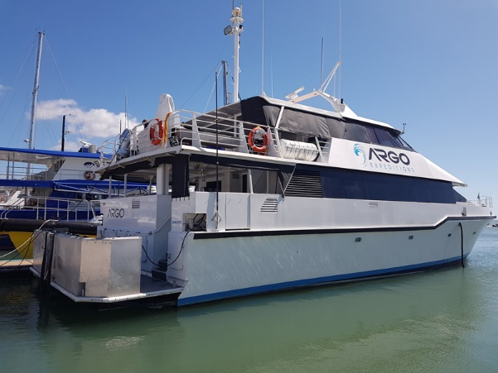





Vessels

Slide 62


Installation
SmartLog USB data logger
Calibration
marine technician to install
12/24VDC plus NMEA channel 1
all sensor offsets measured
lead line check against depths

Slide 63


Processing
Python
Caris HIPS and SIPS
first pass filter from GGA, RMC, DBT
lat,long,date,time,course,speed,depth
report of errors, valid data points, %
Generic Data Parser
assumes 1500 m/sec, but GBR shelf 1538 m/sec, so depth x1.025689

Slide 64



Results
data extends from Cape York to Moreton Bay
10,170 line km (equivalent to crossing Perth-Sydney 3X)
1,432,353 depth soundings (collected every ~2sec)
min depth 2.6 m, max depth 704 m

Slide 65
Costs
Installation:
$450 per logger
$10 per USB stick
$500 marine tech
$1000 per vessel
Processing:
$1000 Fledermaus
$3800 Caris HIPS
$???? your time
$4800 per year
Versus $1000 to $10,000 vessel costs per day

Slide 66
Future work
complete JCU as IHO ‘Trusted Node’
upload clean (untided) data to IHO DCDB
send clean (untided) data to AHO via AH68 form
generate total propagated error for each vessel
develop crowdsourced bathy guideline for Australia
aim for 20 vessels by end of 2019
raise more funds

Slide 67
Acknowledge
Petra Lundgren – GBR Foundation
Richard Fitzpatrick – Biopixel
David Paton – Blue Planet Marine
Scott Leishman – Cairns Marine
Ross Miller – Aroona Expeditions
Andrew Gill – North Keppel Is Environ. Education Centre
Andrew Moss – Qld Dept of Environment and Science
Craig Stephen – Mike Ball Dive Expeditions

Slide 68
Annual Reports
Program Themes
Nathan Quadros
July 2019

Slide 69
Annual Report Summary: Data Hub
Update: Kim Picard
Addressed a broad range of scoping and outreach activities to assist in developing the data hub infrastructure and AusSeabed portal.
The WG in 2018/19 is contributing the following to the Australian seabed mapping community:
  Improved discoverability and accessibility of seabed data through the delivery of datasets into portals, such as AusSeabed, AODN and ELVIS
  Data standards and specifications to facilitate interoperability ingestion into the data hub and quality assurance
  Improved coordination and collaboration amongst the community through workshops

Slide 70
Annual Report Summary: Tools, Standards and Guidelines
Update: Nathan Quadros
Established the priority 12 tasks covering a range of guidance material for seabed mapping, such as vertical datums, crowd-sourcing, LiDAR, satellite-derived bathymetry, MBES, data processing and performance testing.
The WG in 2018/19 is contributing the following to the Australian seabed mapping community:
  Guiding the coverage of seabed mapping to the highest priority areas through the Priority Map Review
  Providing coordination and guidance to non-technical and inexperienced seabed mapping users through a Survey and Planning Tool.

Slide 71
Annual Report Summary: Education, Training and Outreach
Update: Ralph Talbot-Smith
Addressed a range of activities mainly focused on outreach.
The WG in 2018/19 is contributing the following to the Australian seabed mapping community:
  The delivery of a consistent message to both the existing community and potential collaborators, resulting in the trust and growth of the AusSeabed community
  The national and international recognition and influence of AusSeabed
  The opportunity to develop experience and growth knowledge in the field of seabed mapping

Slide 72
2019-20 Work Plans
Program Themes
Nathan Quadros
July 2019

Slide 73
2019-20 Work Plan: Data Hub
What is the 12-month vision for the Data Hub for 2019-20?
What are the outcomes we’d like to see in 2019-20?
How will this be achieved? By Whom?
How will we measure success?
What issues will we need to overcome?
What are the major risks?
REFERENCE: Section 6, ASB Strategic Plan

Slide 74
2019-20 Work Plan: Tools, Standards and Guidelines
What is the 12-month vision for TSG for 2019-20?
What are the outcomes we’d like to see in 2019-20?
How will this be achieved? By Whom?
How will we measure success?
What issues will we need to overcome?
What are the major risks?
REFERENCE: Section 6, ASB Strategic Plan

Slide 75
2019-20 Work Plan: Education, Training and Outreach
What is the 12-month vision for ETO for 2019-20?
What are the outcomes we’d like to see in 2019-20?
How will this be achieved? By Whom?
How will we measure success?
What issues will we need to overcome?
What are the major risks?
REFERENCE: Section 6, ASB Strategic Plan

Slide 76
Closing Remarks
A big thank you to our host Jay Illingworth , Fremantle Ports, and to for helping organise the workshop.
Thanks to all of you, for being such an engaged community.
If you are free we will be heading over to the Little Creatures Brewery—please join us!

